Slide 1
Module 3.2
PRE-CLASS CONTENT
Rules of Inference

Slide 2
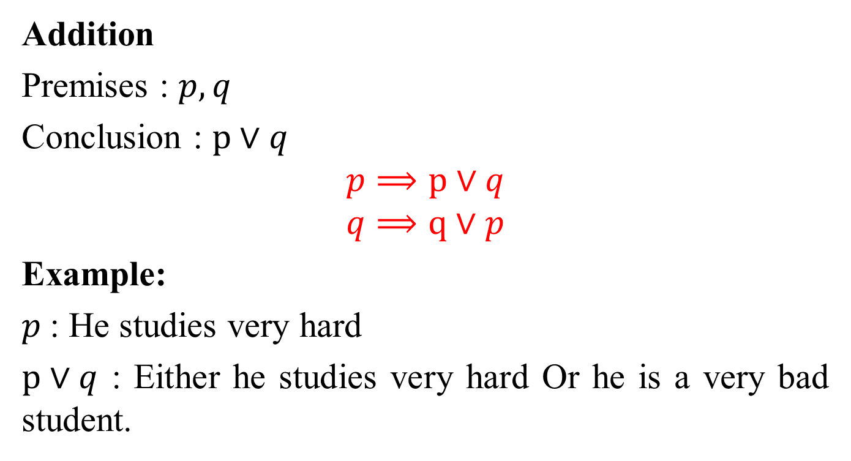
Rules of Inference
Addition
Premises : $p, q$
Conclusion : $p∨q$
$$p⟹p∨q$$
$$q⟹q∨p$$
Example:
$p$: He studies very hard
$p∨q$ : Either he studies very hard Or he is a very bad student.

Slide 3
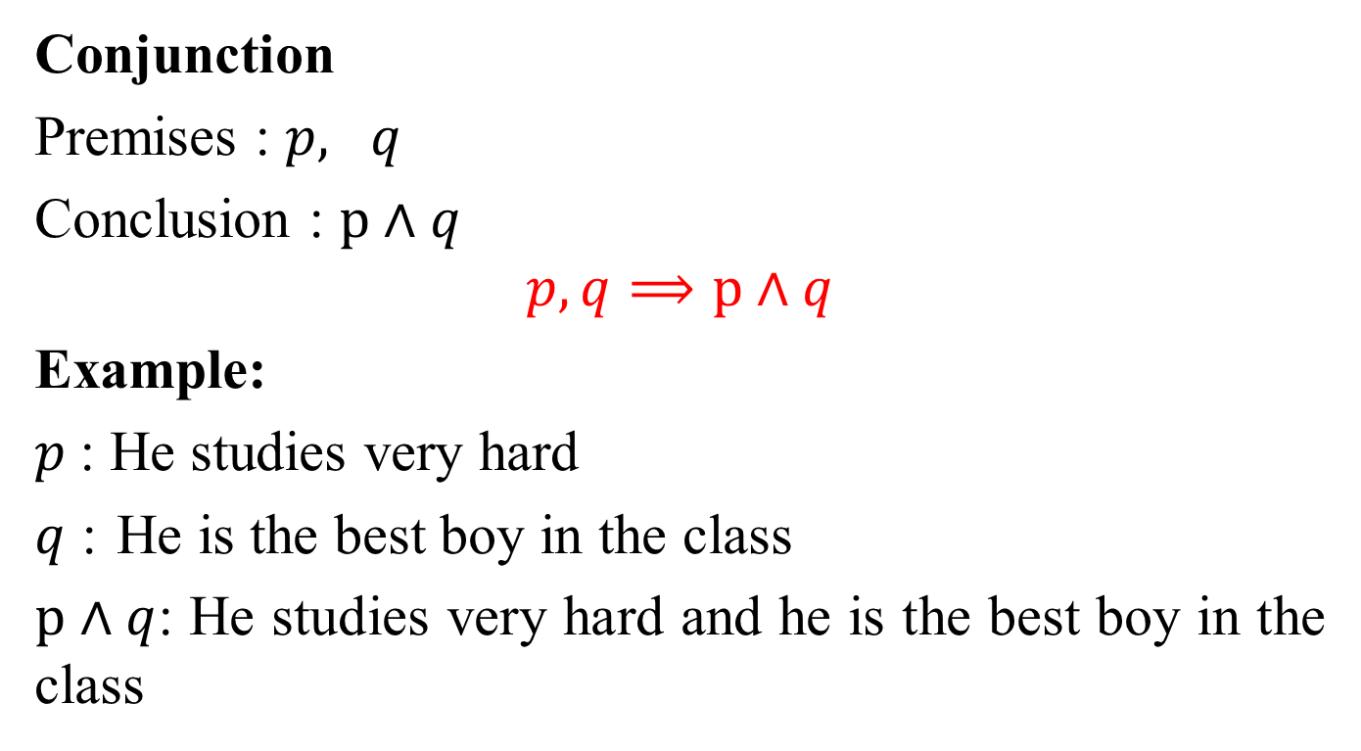
Rules of Inference
Conjunction
Premises : $p, q$
Conclusion : $p∧q$
$$p, q⟹p∧q$$
Example:
$p$: He studies very hard
$q$ : He is the best boy in the class
$p∧q$: He studies very hard and he is the best boy in the class

Slide 4
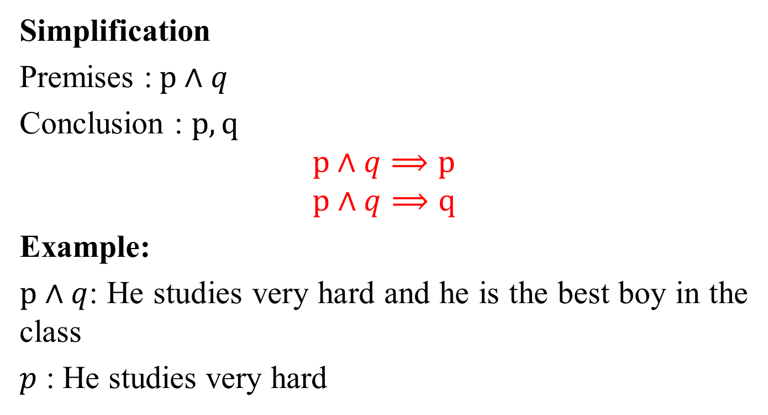
Rules of Inference
Simplification
Premises :$p∧q$
Conclusion : $p, q$
$$p∧q⟹p$$
$$p∧q⟹q$$
Example:
$p∧q$: He studies very hard and he is the best boy in the class
$p$ : He studies very hard

Slide 5
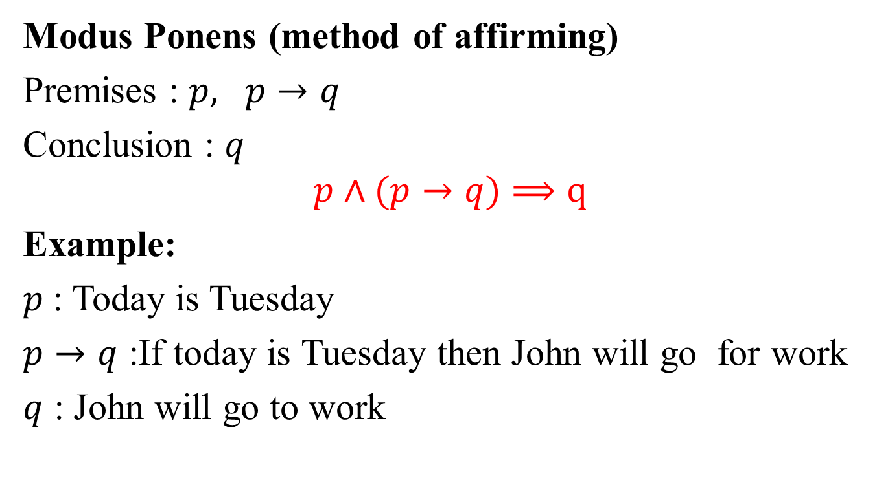
Rules of Inference
Modus Ponens (method of affirming)
Premises : $p, p→q$
Conclusion : $q$
$$p∧(p→q)⟹q$$
Example:
$p$: Today is Tuesday
$p→q$ :If today is Tuesday then John will go for work
$q$ : John will go to work

Slide 6
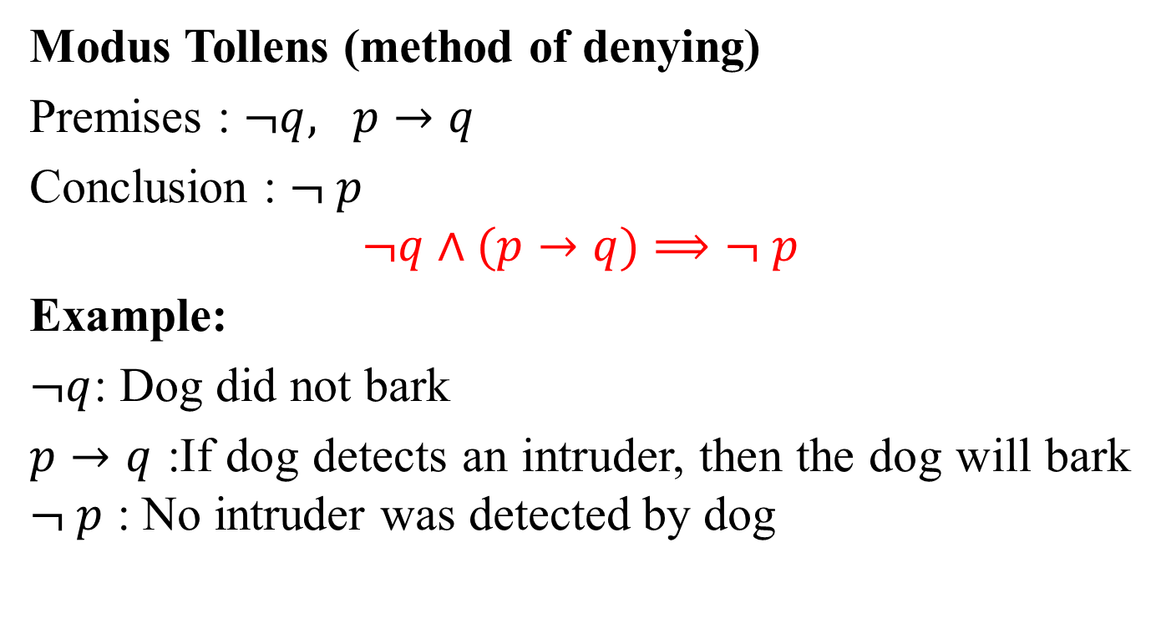
Rules of Inference
Modus Tollens (method of denying)
Premises : $¬q, p→q$
Conclusion : $¬ p$
$$¬q∧(p→q)⟹¬ p$$
Example:
$¬q$: Dog did not bark
$p→q$ :If dog detects an intruder, then the dog will bark $¬ p$ : No intruder was detected by dog

Slide 7
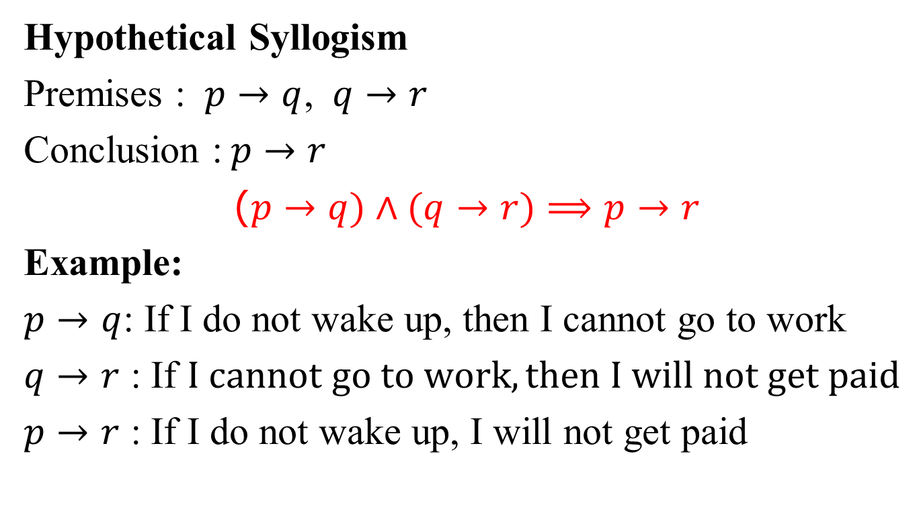
Rules of Inference
Hypothetical Syllogism
Premises : $p→q$, $q→r$
Conclusion :$p→r$
($p→q)∧(q→r)⟹p→r$
Example:
$p→q$: If I do not wake up, then I cannot go to work
$q→r$ : If $I cannot go to work, then I will not get paid$
$p→r$ : If I do not wake up, I will not get paid

Slide 8
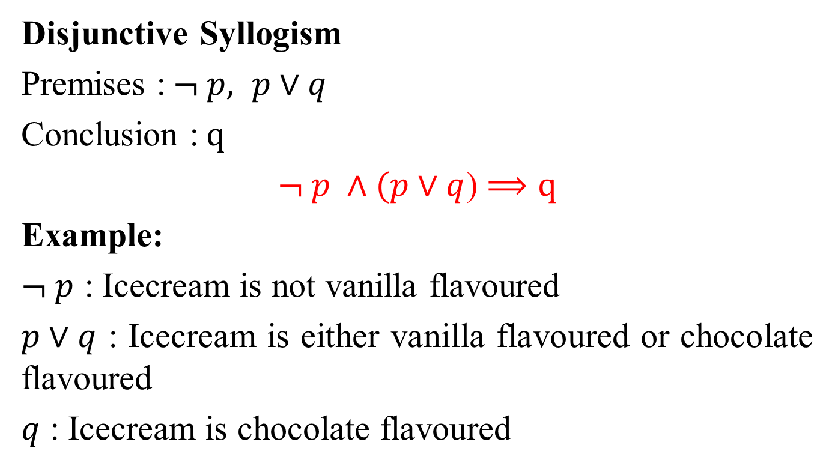
Rules of Inference
Disjunctive Syllogism
Premises :$¬ p, p∨q$
Conclusion :$q$
$¬ p ∧(p∨q$) $⟹q$
Example:
$¬ p$ : Icecream is not vanilla flavoured
$p∨q$ : Icecream is either vanilla flavoured or chocolate flavoured
$q$ : Icecream is chocolate flavoured

Slide 9
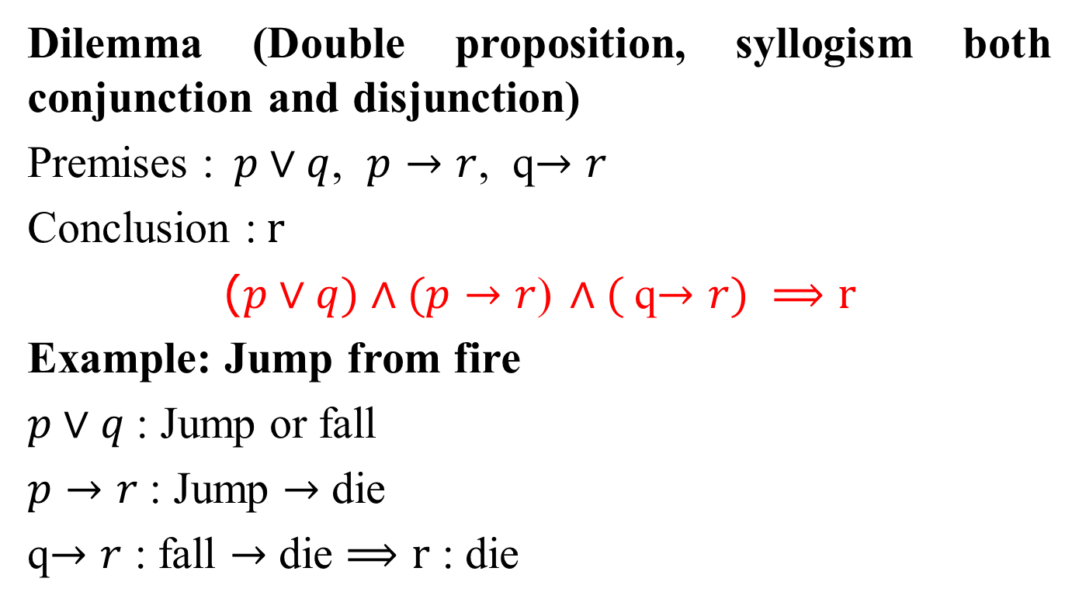
Rules of Inference
Dilemma (Double proposition, syllogism both conjunction and disjunction)
Premises :$p∨q$, $p→r$, q$→r$
Conclusion :$r$
($p∨q)∧(p→r$) $∧($q$→r) ⟹r$
Example: Jump from fire
$p∨q$: Jump or fall
$p→r$: Jump $→$ die
q$→r$ : fall $→$ die $⟹r$ : die

Slide 10
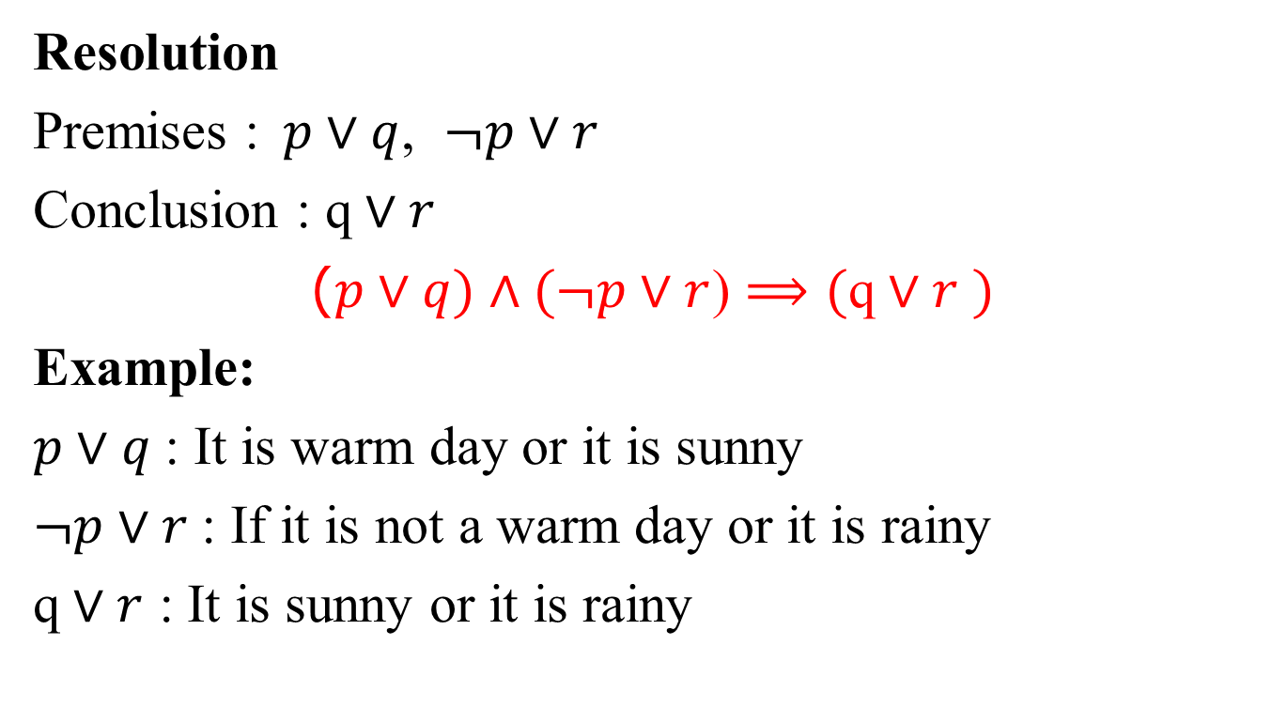
Rules of Inference
Resolution
Premises :$p∨q$, $¬p∨r$
Conclusion : $\text{q}∨r$
($p∨q)∧(¬p∨r$) $⟹(\text{q}∨r$ $)$
Example:
$p∨q$: It is warm day or it is sunny
$¬p∨r$: If it is not a warm day or it is rainy
$\text{q}∨r$ : It is sunny or it is rainy

Slide 11
IN-CLASS CONTENT PROBLEMS

Slide 12
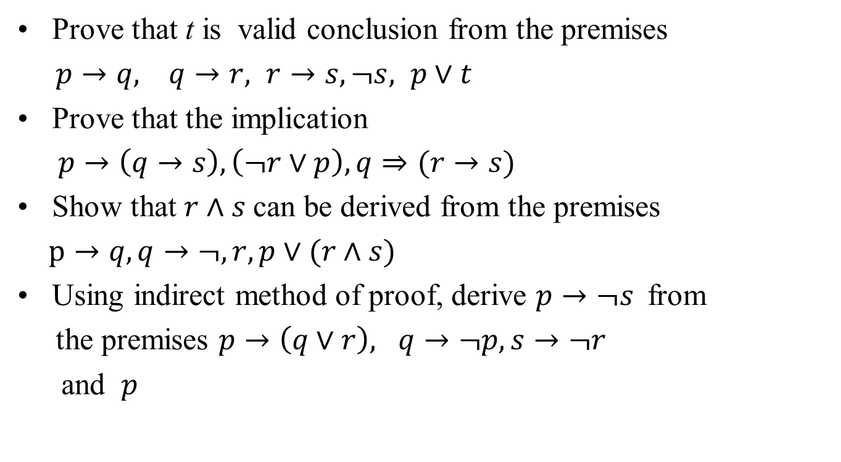
PROBLEMS
Prove that t is valid conclusion from the premises
$p→q, q→r, r→s, ¬s, p∨t$
Prove that the implication
$p→\left(q→s\right), \left(¬r∨p\right), q⇒(r→s)$
Show that $r∧s$can be derived from the premises
$p→q, q→¬, r, p∨(r∧s)$
Using indirect method of proof, derive $p→¬s$from
the premises $p→\left(q∨r\right), q→¬p, s→¬r$
and $p$

Slide 13
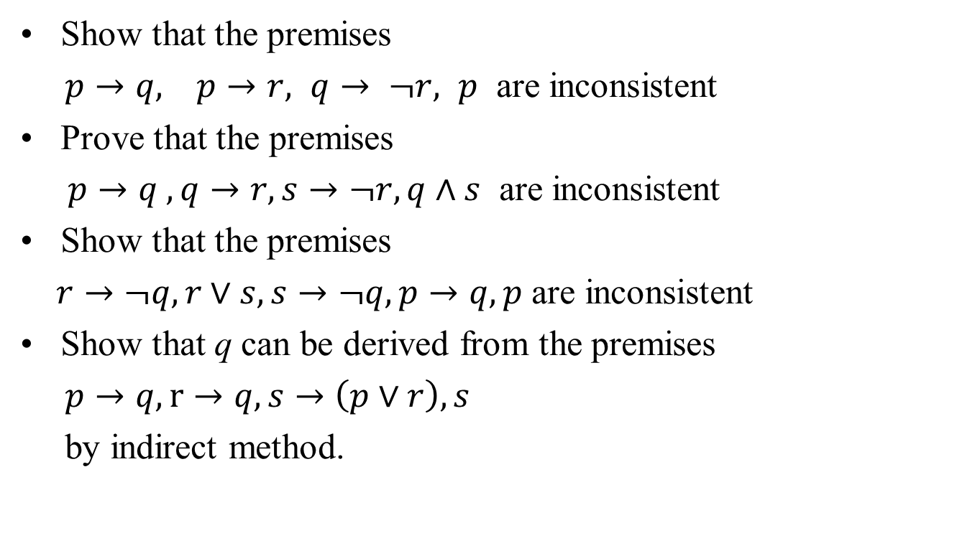
PROBLEMS
Show that the premises
$p→q, p→r, q→ ¬r, p$ are inconsistent
Prove that the premises
$p→q , q→r,s→¬r,q∧s$ are inconsistent
Show that the premises
$r→¬q, r∨s,s→¬q,p→q,p$ are inconsistent
Show that q can be derived from the premises
$p→q, r→q,s→\left(p∨r\right), s$
by indirect method.

Slide 14
PROBLEMS
Show that the following premises are inconsistent
If Jack misses many classes through illness, then he
fails high school.
If Jack reads a lot of books, then he is uneducated.
If Jack reads a lot of books, then he is not uneducated.
Jack misses many classes through illness and reads a
lot of books.
Symbolize the statement “Given any positive integer, there is a greater positive integer”
With positive integers as universe of discourse
Without positive integers as universe of discourse

